Slide 1
Chapter 19: The Age of Enlightenment
Mid 1700s-1800
Art, Literature and Society
By Priyanka Vaddi
Period 5

Slide 2
Main Themes
The Enlightenment was a self-conscious movement of intellectual who reworked seventeenth-century ideas in hope that such ideas would make people more rational, tolerant, virtuous and free.
High culture was dominated by the French. Characteristic trends were a dramatic increase in the number of publications, a flowering of academies and salons, the rise of the novel, and the development of the symphony.
Popular culture remained recreational, public, collective and oral.
Neoclassicism remained the popular style of this age.

Slide 3
High Culture
French was an international language. This allowed the free flow of ideas past language barriers.
Traveling to the large cities and the ruins of antiquity became common-- the “grand tour”.
Additions to urban life were the coffeehouse and the storefront window display.
“Republic of letters”– a self-proclaimed community of scholars and literary figures that stretched across national boundaries. They corresponded using letters, and the expansion of this correspondence brought new members.
Salons– usually organized by wealthy women; brought together important writers with the influential persons they needed for favors and patronage.

Slide 4
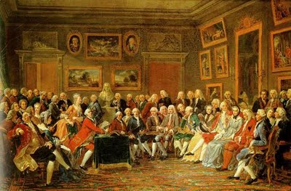
Salons were very important for the spreading of ideas of the philosophes and to enlarge their audience and contacts.
In the salons, men learned to take women seriously.
Freemasonry was also a form of sociability. Originated as clubs or fraternities and went beyond the lines of class.
Learned Academies— French provincial academies became important. They often focused on the kind of subjects dealt with in the Encyclopedia and increasingly opened membership to commoners.

Slide 5
Publishing and Reading
Notable rise in publishing and the reading public.
Traveling circulating libraries originated in England.
“Booksellers” played the role of a modern day publisher, editor, printer, and salesperson.
Periodicals such as Spectator, The Female Spectator, Gentleman’s magazine and papers like the London Chronicle, proliferated.
“Bad books” also became common. Romances, gossip sheets, and perversions of ruler or courtiers and the like were of low taste and lack of quality, but helped “desacralize” monarchy.

Slide 6
Neoclassicism
A widespread movement in visual arts that began in the 1760s.
In paintings, Neoclassicism is shown in the emphasis on linear design in the depiction of classical themes and subject matter, using archaeologically correct settings and costumes.
Neoclassicism is a reaction against the frivolity of the Rococo style.
A more profound stimulus was the new scientific interest in classical antiquity.

Slide 7
Literature
The modern novel had its strongest development in England. New genre pioneered by Samuel Richardson, author of Pamela, who also inspired Henry Fielding, a playwright, to write his own novels.
The novel emerged as a form of fiction that told its story and treated the development of personality in a realistic social context.
Poetry retained its qualities of neoclassical tradition. Eventually the restraints of Neoclassicism provoked rebellion.
Romanticism-- The celebration of individual feeling and inner passion.
  William Wordsworth
  Johann von Goethe: Strum and Drang– emphasized strong artistic emotions.
  Jonathan Swift ( Gulliver’s Travels)

Slide 8
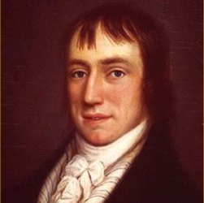
William Wordsworth
English poet
Mother died at age 8. This shaped he later works.
When he was in school, his father died, leaving him to take care of his four siblings.
He visited France, and while there had a daughter out of wedlock, but left before she was born.
His most famous work was The Prelude.
When his daughter Dora died, William had seemed to have lost his will to compose poems.

Slide 9
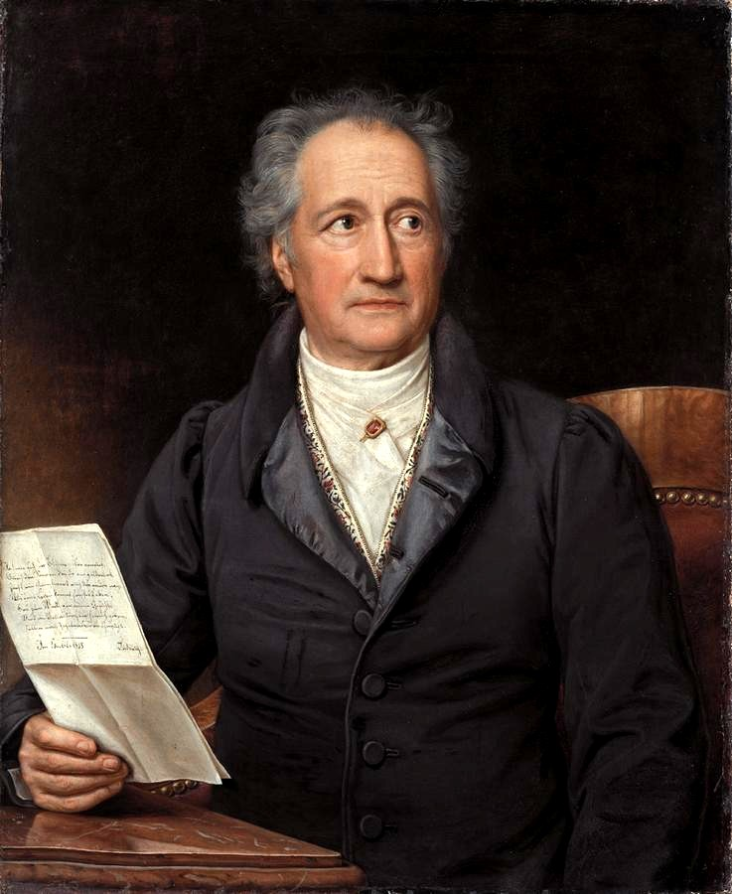
Johann Wolfgang von Goethe
German poet, playwright, novelist and natural philosopher.
Best known for his two-part drama Faust.
Goethe was the most dominating writer of the period.
He had a grasp of Greek, Latin, French and Italian by age 8.
He went to university at age 16 to study law as his father wanted, but that didn’t work out too well.
He had climbed Mount Vesuvius.
Napoleon was an avid reader of Goethe’s works.

Slide 10
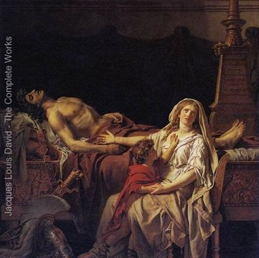
Art
Jacques Louis David– A highly influential painter of the neoclassical style, and the most triumphant painter of the French Revolution.
The public began to claim role as the judge of talent in the visual arts. An annual public exhibition was held.
David’s paintings overwhelmed the public with its vivid imagery and emotion.
Jean-Baptiste Greuze– another hit painter emphasized the ordinary people.
Andromache mourning Hector

Slide 11

Music
Heart of music shifted to Austria.
Franz Joseph Haydn and Wolfgang Amadeus Mozart were at first conventional, but at the end of their careers, they had transformed symphonic form.
Ludwig van Beethoven ensured that this symphony would be adaptable.
Music in Beethoven’s Ninth Symphony provides a bridge between 18th century classicism and 19th century romanticism.
Aristocratic and court patronage was the surest way to have a career in music.

Slide 12
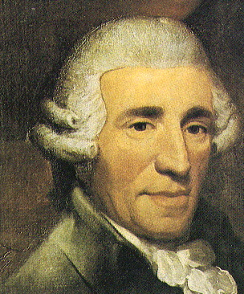
Franz Joseph Haydn
Austrian composer
Often called “Father of the Symphony”
Haydn used to sing as a young boy, and pretty well as he was a chorister for nine years. He was then fired when he matured and could not sing the high choral part and snipped off the ponytail of a fellow chorister.
He was a court musician for most of his career in a remote estate, and was “forced to become original.”

Slide 13
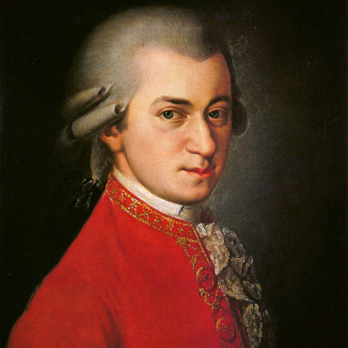
Wolfgang AMADEUS MOZART
Austrian composer
Baptismal name is Johannes Chrysostomus Wolfgangus Theophilus Mozart
Mozart was very talented; he wrote in all musical genres and excelled in each one.
He began playing instruments at 3 years old and was composing by the time he was 5.
Mozart was afraid of the trumpet.

Slide 14
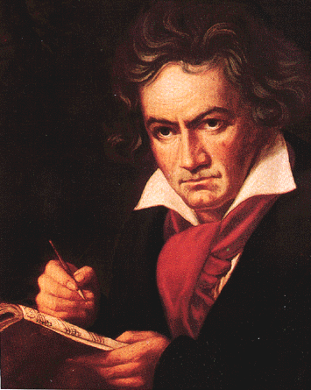
LUDWIG VAN Beethoven
Deaf composer
Considered greatest composer of all time
Beethoven believed he was born in 1772 when all evidence proved beyond doubt that he was born in 1770.
As a child, Beethoven was taught music with a brutal vigor by his father. Nearly on daily basis, he would be flogged for any hesitancy and deprived of sleep for practice.

Slide 15
Popular Culture
Popular Literature
  For the journeymen and the peasants, publishers created small, cheap booklets sold by peddlers.
  Three types: Religious material, Almanacs, and tales for entertainment.
  Oral Tradition– folktales and songs passed down generations.
  Oral tradition was more common in the working-class than written forms.

Slide 16
Literacy and Primary Schooling
Religious wars had spurred the spread of literacy and elementary schooling in Europe.
Protestantism explicitly promoted literacy so Christians could read their Bibles directly.
Literacy rates rose, especially in urban areas.
Schooling was intended to maintain order and promote piety and good values. The goal of elementary schooling was to promote religion, morality and hard work.
The Habsburgs seriously promoted primary schooling; The Habsburg General School Ordinance of 1774, which organized state subsidies in combination with school funds, for support of a school.
Schoolmasters in most of Europe were barely competent and poorly paid.

Slide 17
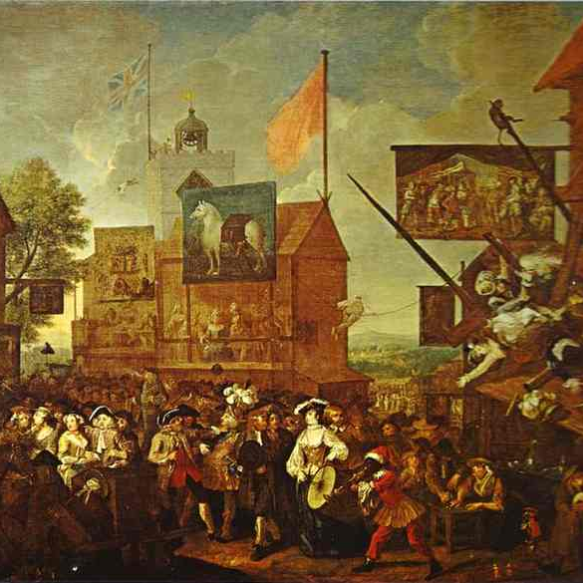
Sociability and Recreation
The common people also formed cultural groups.
Similar to coffeehouses, the working-class neighborhoods had taverns.
Local festival, fairs, markets, sporting events, public feasts and such provide opportunities for the people to gather for recreation.
Elite groups, concerned with manners began to distance themselves from ordinary people.

Slide 18
Suggestions
Look over chapter again recall terms and important individuals.
Read Sherman study guide for overview of the chapter.
Take the chapter quizzes on Mr. Kinberg’s webpage, they are very helpful.
Try to answer the questions at the end of the chapter and in the Sherman study guide.
Extra research from outside sources if also very beneficial.

